Slide 1

Opportunities online
RSHE - Online and media: Rights, responsibilities and keeping safe

Slide 2
Intro quiz ✓
What positive opportunities are there to being online?
How might we use the Internet as we get older?
Reflection
Exit quiz

Slide 3
Keywords
The internet is the large network of connected computers around the world. It allows people to share information and communicate with each other.
Social media includes websites and programs which allows people to communicate and share information on the internet.

Slide 4
How do you use the internet?
Task
Task 1
Create a spider diagram to show all of the ways in which you use the internet.

Slide 5
Task
Task 1 - feedback
Research for homework
Access web programs for school work
Online shopping - to buy presents or games online
How do I use the internet?
Connect to an online gaming platform
Access social media
Watch videos or vlogs
Access my school website
Reading blogs

Slide 6
Using the internet to socialise and build friendships

Slide 7
Socialising online
Many people use the internet to socialise and to build friendships. They may do this through:
Online gaming
Social media platforms
Playing video games whilst being connected to the internet
Websites and applications used to participate in social networking
Community forums
Interest groups
Online discussion pages for local communities
Forums for people who share joy in the same hobbies, sports and volunteering opportunities

Slide 8

Socialising online
Aisha has had a wonderful day shopping and exploring Leicester with her family and wants to share her pictures with her friends. Which one of these options might Aisha choose to do this?
Online gaming
Social media platforms
Community forums
Interest groups

Slide 9

Socialising online
Joseph’s school are trying to raise funds for a school bus to help take his football club to matches and the team is going to pack bags at the local supermarket to help. Where might Joseph’s parents advertise this to gain more exposure?
Online gaming
Social media platforms
Community forums
Interest groups

Slide 10
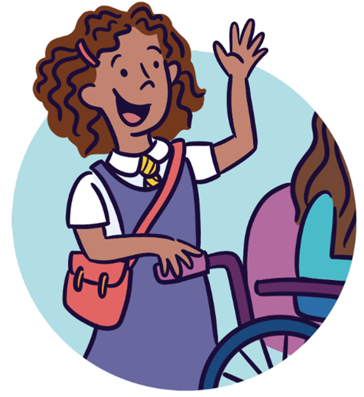
Socialising online
For her birthday, Izzy was given a new console. When she told her friends, they invited her to join them online tonight. Which one of these options will she use?
Online gaming
Social media platforms
Community forums
Interest groups

Slide 11

Socialising online
Nicky has decided to take up boxing. He knows there is a local group and his parents have said they will take him next Friday. Nicky is feeling nervous and wants to find out more. Which of these options would help Nicky?
Online gaming
Social media platforms
Community forums
Interest groups

Slide 12
Learning and sharing knowledge

Slide 13
Learning and sharing knowledge
Many people use the internet to research for, and share, knowledge.
Researching a topic
Sharing information
This may be to complete homework, to complete a project, learn more about a topic etc.
A person may have spent a lot of time studying a topic and want to share their knowledge with others.
Personal interest
Personal development
There are many people who hold personal interests in something and want to find out more or share this with others.
If someone wants to develop their knowledge or skills in a particular area, they may use the internet to find out more.

Slide 14
Task
Task 2
Look back at your spider diagram.
Think about times when you have used the internet to help you to learn or share knowledge.
Add some notes about this onto your spider diagram.

Slide 15
Task
Task 2 - feedback
Online shopping - to buy presents or games online
What to buy? Which is the best brand? How much does it cost?
Connect to an online gaming platform
Which games have the highest users? Best headsets? Video tips
Access web programs for school work
Homework websites, reading programs, spelling support etc.
Access my school website
Selecting a secondary school, uniform, times of the day
Reading blogs
How to...guides, fashion, lifestyle
Watch videos or vlogs
Gaming tips, homework support

Slide 16
Using the internet as we get older

Slide 17


How might I use the internet as I get older?
Finding a job
Finding a course
Credit: Pixabay

Slide 18
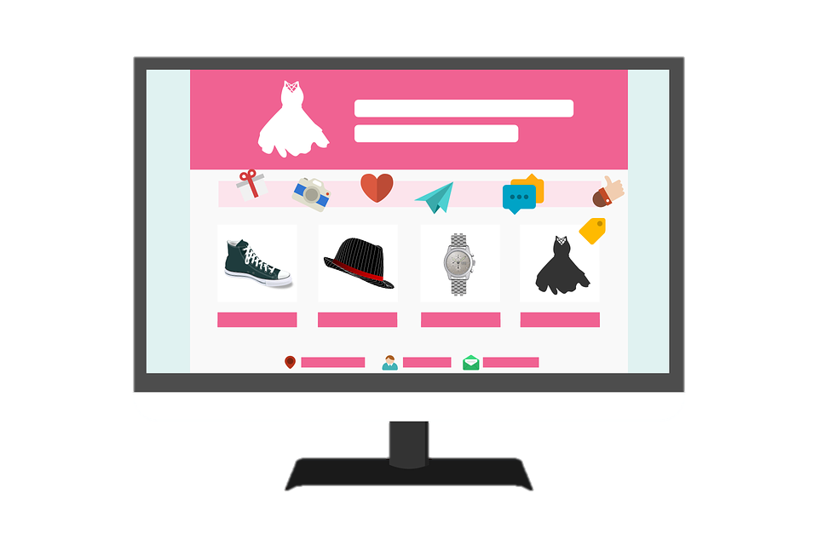

How might I use the internet as I get older?
Buying products
Selling products
Credit: Pixabay

Slide 19



How might I use the internet as I get older?
Applying for a passport
Applying for a driver’s license
Registering to vote
Credit: Pixabay

Slide 20

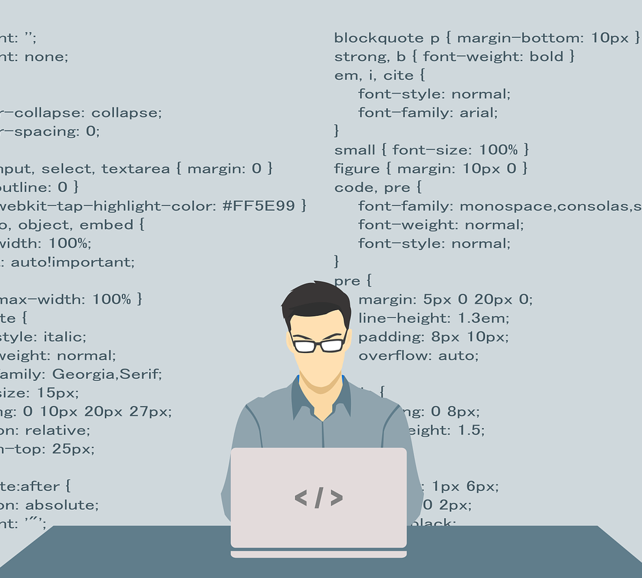

How might I use the internet as I get older?
To access entertainment
Publishing information, e.g. in a blog
Relaxation, exercise and learning new skills
Credit: Pixabay

Slide 21
Task
Task 3
Why might an adult choose to use a online platform to complete forms, as opposed to a paper forms?
Passport application
Driver’s licence application
Job applications
Think about:
Time.
Ease of access.
Autofill options.
School applications
Voter registration form

Slide 22
Task
Task 3 - feedback
You don’t need to go into a branch/office to collect the forms.
It is quicker to receive and send the application. You can also ask for a read receipt to check that it has arrived.
It looks neater and tidier; this makes it easier for others to check and understand.
Some computers allow you to autofill key pieces of information (including name, address and phone number) saving time.
If you are writing a personal statement, you can copy and paste.

Slide 23
Self-expression online

Slide 24
How do people express themselves online?
People may also use the internet to share appropriate information about themselves. This might be in the form of a blog or vlog, or social media profiles.
Appropriate information will depend on the situation:
Is it safe to share?How old is the person sharing? What is the purpose of sharing? Who is the intended audience? Does the person have permission to share?

Slide 25
How do people express themselves online?
People may write reviews of products, e.g. make up, clothing, books or films etc. or they may share lifestyle tips and advice. Some people may also share information about the difficulties in their lives.
One example was Malala Yousafzai. When she was 11 years old, she wrote an anonymous blog for the BBC about life under the Taliban. This was an outlet for her and it allowed the world to find out more about the difficulties that people in Mingora, the northwest region of Pakistan, were facing.

Slide 26
Task
Task 4
With the rise of social media and vlogging, more people are wanting to share personal information with other people.
What are the benefits and drawbacks of doing this?
You can do this as a list or create a table to help you set your response out clearly.
Benefits of sharing online | Drawbacks of sharing online

Slide 27
Task
Task 4 - feedback
Benefits of sharing online
Keep connected with friends and family members. It may help you to find a job / career. It can be an outlet for your emotions and expressive side. Advertising may become tailored to your likes and dislikes. You can raise awareness/educate others about things you are passionate about.

Slide 28
Task
Task 4 - feedback
Drawbacks of sharing online
Your information may reach people outside of your trusted circle. Details become public, and so less personal to you. Once your information is online, it is extremely difficult to delete it. You may receive spam or junk mail. You may receive negative feedback, which may upset you.

Slide 29
Reflection

Slide 30
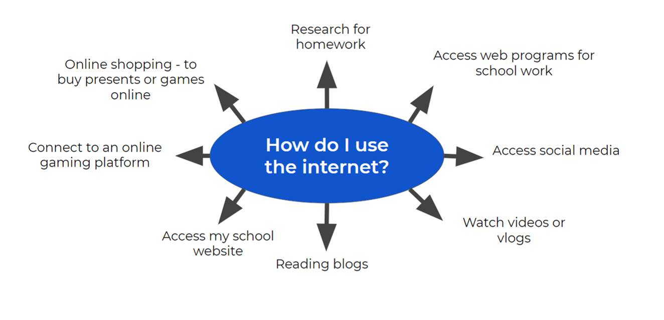
Task
Task - Reflection
Look back at your spider diagram.
Now that we have explored many opportunities online, reflect on your use of the internet.
Can you include more ways in which you use the internet?

