Slide 1
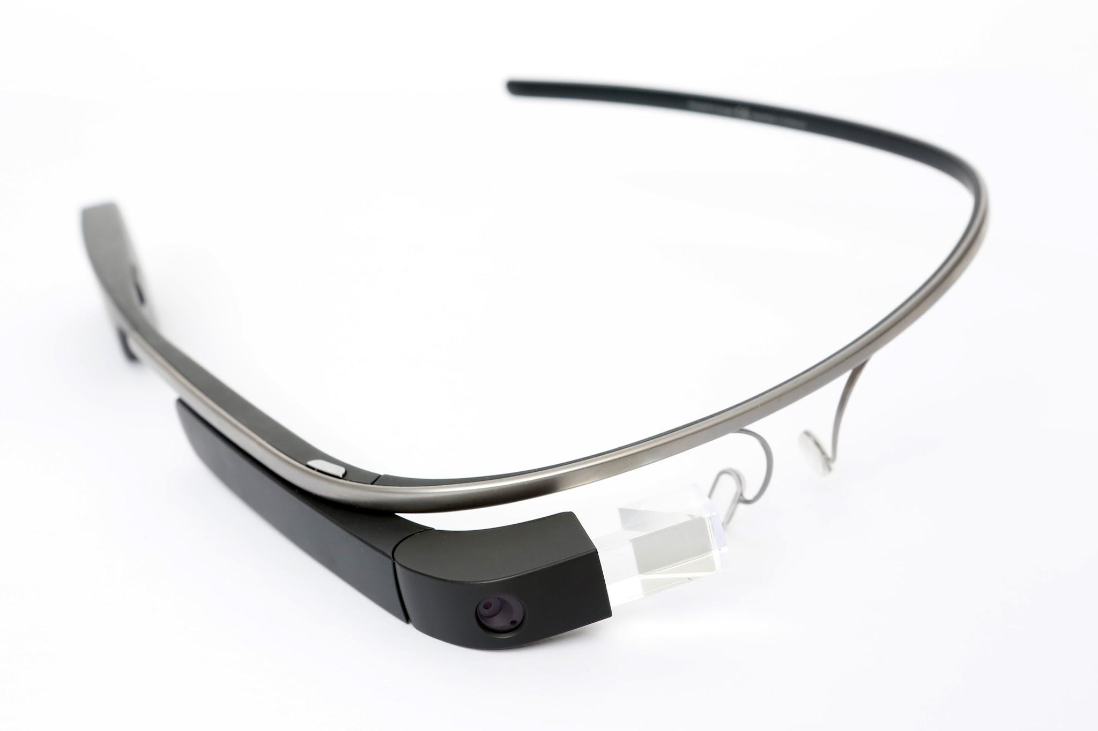
Year 8 – How Computers Work Lesson 2 – Under the hood | Worksheet
Wearable computing
The image below shows several different hardware components of a wearable computing system called Google Glass. Label each component using one of the labels provided on the left.
Memory
Storage
Speaker
Processor
Communication
Input
Output
Program execution
Image source: commons.wikimedia.org/wiki/File:Google_Glass_Main.jpg
Program & data
(volatile storage)
Program & data (persistent storage)
Data exchange with other systems
Touchpad
Camera
Screen
Sensors
Microphones
This resource is licensed under the Open Government Licence, version 3. For more information on this licence, see ncce.io/ogl.

