Slide 1
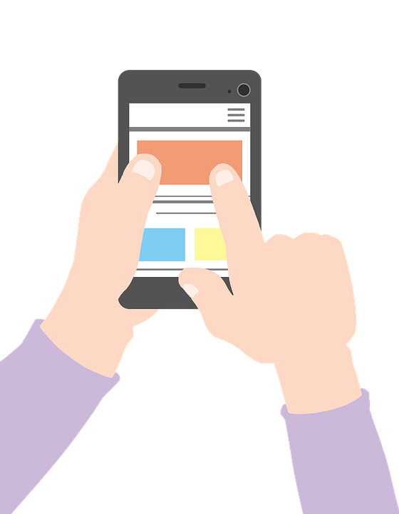
Bourne Grammar Studios
Your Weight in Space
Notes:
Last updated: 01-07-20
Image source: https://pixabay.com/illustrations/smartphone-app-news-web-internet-1184883

Slide 2
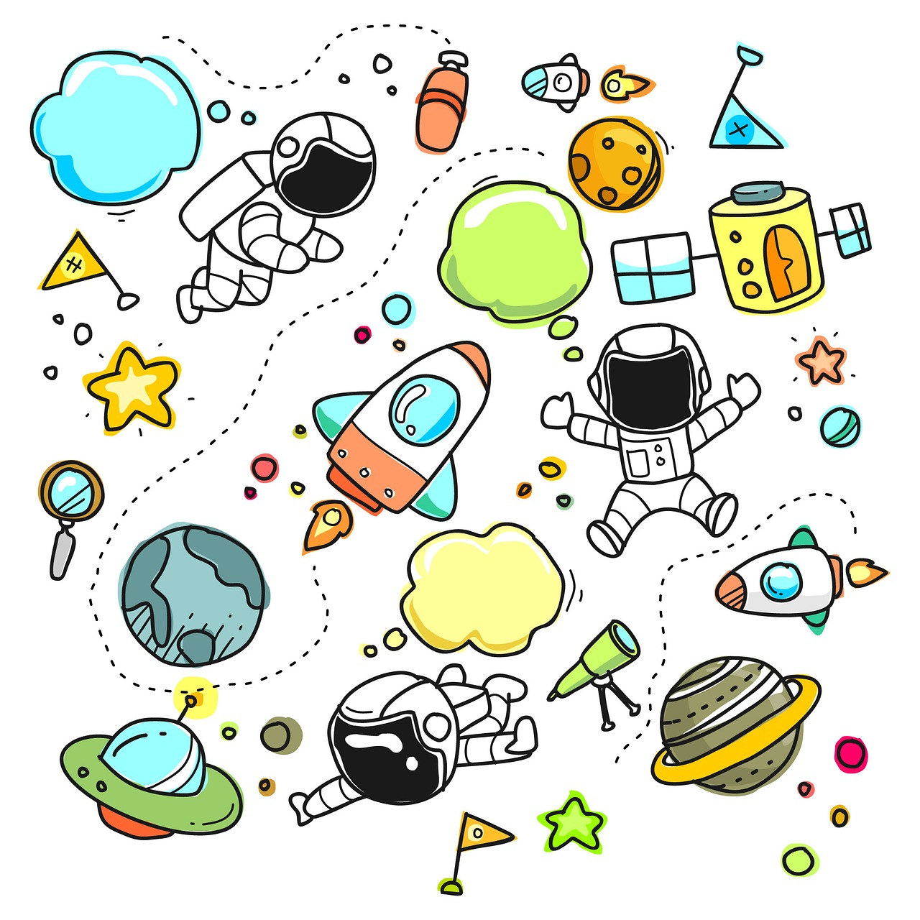
Your Weight in Space
Project description
This app will allow the user to work out their own weight in space and on different planets in our solar system.
Weight in N = mass in kg × gravitational field strength in N/kg
The user can enter their weight in kilograms and the app will tell them what they weigh on at least three planets other than Earth
Click here for more information
Notes:
Space image: https://pixabay.com/illustrations/sketch-cartoon-space-set-3045125

Slide 3
Project 2: Further instructions
Project description
The app must first work out a user’s mass from their weight, which they enter into the app, in kilograms.
Mass = weight in kg x 9.81
Notes:
Space image: https://pixabay.com/illustrations/sketch-cartoon-space-set-3045125

Slide 4
Project 2: Success criteria
Success criteria
Below are some mandatory success criteria. You should add between two and four additional success criteria that you would like your project to be judged on​.
Success criterion | Met?
1. The app must have a welcome screen with a button to start the program.
2. The app must allow the user to enter their mass in kilograms.
3. The app must show the user what they weigh on the planets [enter planets here].
4.
5.
6.
7.

Slide 5
Screen designs

Slide 6
Decompose the problem
Decomposition
Use the table below to document how you intend to decompose the problem. Don’t overcomplicate this by adding too many steps; remember that each step can be decomposed further, and use your success criteria as a guide to help you.
Step | Further decomposition
 | 1. 2.

Slide 7
Diary milestone 1
Milestone 1
What have you achieved in this lesson? Don’t forget to include information on anything that went wrong and how you resolved the issues.
Screenshot
What do you need to focus on in the next lesson?

Slide 8
Feedback
Peer feedback
What do you think could be done to help the app meet the success criteria? What other suggestions do you have?
Success criterion | Met?
1. The app must have a welcome screen with a button to start the program.
2. The app must allow the user to enter their mass in kilograms.
3. The app must show the user what they weigh on the planets [enter planets here].
4.
5.
6.
7.
What do you think users will like most about the app?

Slide 9
Diary milestone 2
Milestone 2
What have you achieved this lesson? Don’t forget to include information on anything that went wrong and how you resolved the issues.
Screenshot
What do you need to focus on in the next lesson?

Slide 10
Evaluation
Project evaluation
Questions | Responses
Do you think your app will be successful, and why? (For example, which features do you think will appeal to the audience?)
Based on the feedback from your user, what do you think could be improved upon if you had had more time?​
What additional features would you like to add to the app in the future to help keep people engaged with it?

