Slide 1
Bourne Grammar Studios
Virtual Pet
Notes:
Last updated: 01-07-20
Image source: https://pixabay.com/illustrations/smartphone-app-news-web-internet-1184883

Slide 2
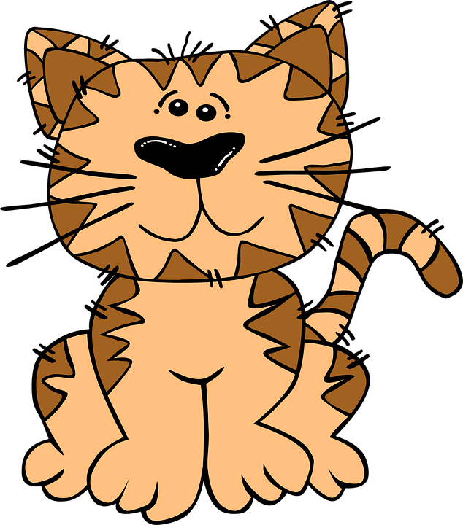
Virtual Pet
Project description
How well can you look after a pet?
In this app, the user will need to feed and exercise their virtual pet. Be careful, because too much food will not be good for the pet and the game will end if you forget about looking after the poor thing.
Notes:
Image source: https://pixabay.com/vectors/school-school-supplies-education-1555910

Slide 3
Project 1: Success criteria
Success criteria
Below are some mandatory success criteria. You should add between two and four additional success criteria that you would like your project to be judged on​.
Success criterion | Met?
1. There must be buttons to allow the user to ‘feed’ and ‘exercise’ their pet.
2. The values of Feed and Exercise must increase by one each time the button is clicked.
3. The values of Feed and Exercise must decrease by a minimum of three at random time intervals of three to ten seconds.
4. If the value of Feed or Exercise is zero or below, the game must stop and go to a ‘Game over’ screen.
5.
6.
7.

Slide 4
Screen designs

Slide 5
Decompose the problem
Decomposition
Use the table below to document how you intend to decompose the problem. Don’t overcomplicate this by adding too many steps; remember that each step can be decomposed further, and use your success criteria as a guide to help you.
Step | Further decomposition
 | 1. 2.

Slide 6
Diary milestone 1
Milestone 1
What have you achieved in this lesson? Don’t forget to include information on anything that went wrong and how you resolved the issues.
Screenshot
What do you need to focus on in the next lesson?

Slide 7
Feedback
Peer feedback
What do you think could be done to help the app meet the success criteria? What other suggestions do you have?
Success criterion | Met?
1. There must be buttons to allow the user to ‘feed’ and ‘exercise’ their pet.
2. The values of Feed and Exercise must increase by one each time the button is clicked.
3. The values of Feed and Exercise must decrease by a minimum of three at random time intervals of three to ten seconds.
4. If the value of Feed or Exercise is zero or below, the game must stop and go to a ‘Game over’ screen.
5.
6.
7.
What do you think users will like most about the app?

Slide 8
Diary milestone 2
Milestone 2
What have you achieved this lesson? Don’t forget to include information on anything that went wrong and how you resolved the issues.
Screenshot
What do you need to focus on in the next lesson?

Slide 9
Evaluation
Project evaluation
Questions | Responses
Do you think your app will be successful, and why? (For example, which features do you think will appeal to the audience?)
Based on the feedback from your user, what do you think could be improved upon if you had had more time?​
What additional features would you like to add to the app in the future to help keep people engaged with it?

