Slide 1
Bourne Grammar Studios
KS2 Maths App
Notes:
Last updated: 01-07-20
Image source: https://pixabay.com/illustrations/smartphone-app-news-web-internet-1184883

Slide 2
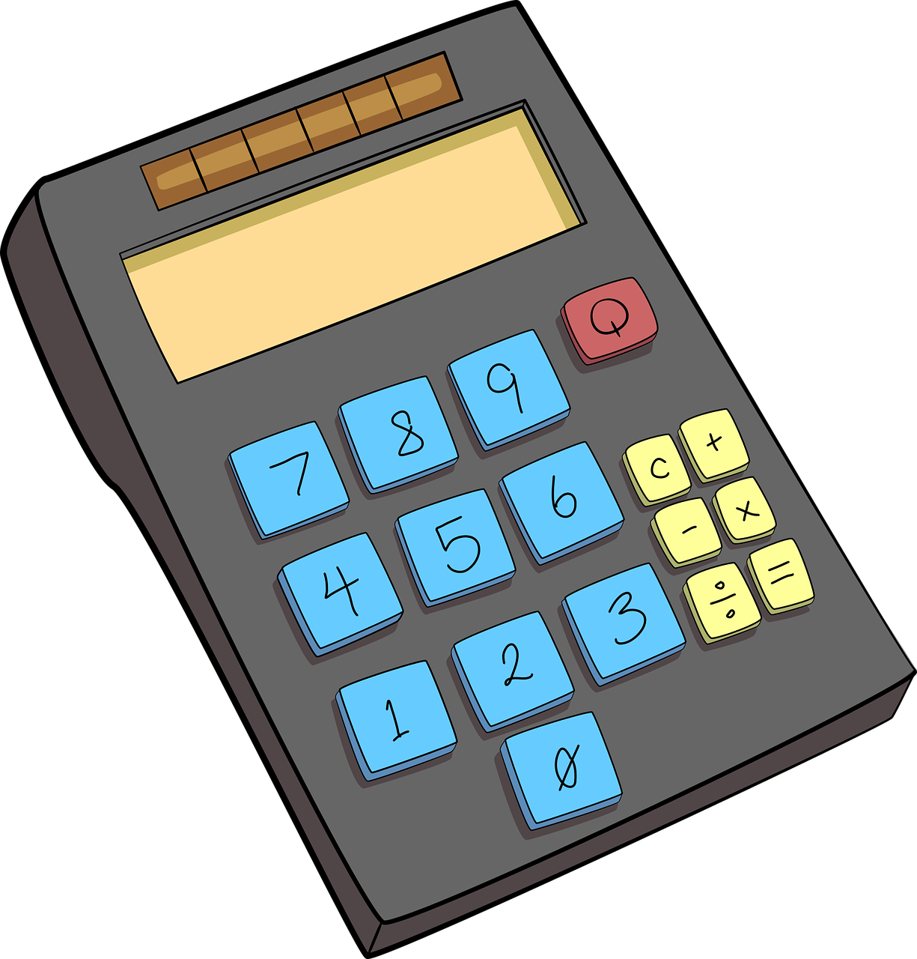
KS2 Maths App
Project description
Learners at KS2 (ages seven to eleven) are expected to know their times tables.
We want an app that KS2 learners can use at home to practise them.
Learners will get to pick different levels of difficulty and be presented with ten questions before being given a final score. The correct answer should be shown after each question.
Notes:
Image source: https://pixabay.com/vectors/school-school-supplies-education-1555910

Slide 3
Project 1: Success criteria
Success criteria
Below are some mandatory success criteria. You should add between two and four additional success criteria that you would like your project to be judged on​.
Success criterion | Met?
1. The app must have a welcome screen and allow the user to select either easy, medium, or hard.
2. Each round must ask ten questions.
3. The numbers must be selected at random.
4. Easy mode will test the 1, 2, 5, and 10 times tables.
5.
6.
7.

Slide 4
Screen designs

Slide 5
Decompose the problem
Decomposition
Use the table below to document how you intend to decompose the problem. Don’t overcomplicate this by adding too many steps; remember that each step can be decomposed further, and use your success criteria as a guide to help you.
Step | Further decomposition
 | 1. 2.

Slide 6
Diary milestone 1
Milestone 1
What have you achieved this lesson? Don’t forget to include information on anything that went wrong and how you resolved the issues.
Screenshot
What do you need to focus on in the next lesson?

Slide 7
Feedback
Peer feedback
What do you think could be done to help the app meet the success criteria? What other suggestions do you have?
Success criterion | Met?
1. The app must have a welcome screen and allow the user to select either easy, medium, or hard.
2. Each round must ask ten questions.
3. The numbers must be selected at random.
4. Easy mode will test the 1, 2, 5, and 10 times tables.
5.
6.
7.
What do you think users will like most about the app?

Slide 8
Diary milestone 2
Milestone 2
What have you achieved this lesson? Don’t forget to include information on anything that went wrong and how you resolved the issues.
Screenshot
What do you need to focus on in the next lesson?

Slide 9
Evaluation
Project evaluation
Questions | Responses
Do you think your app will be successful, and why? (For example, which features do you think will appeal to the audience?)
Based on the feedback from your user, what do you think could be improved upon if you had had more time?​
What additional features would you like to add to the app in the future to help keep people engaged with it?

