Slide 1
Bourne Grammar Studios
Clicky Biscuits
Notes:
Last updated: 01-07-20
Image source: https://pixabay.com/illustrations/smartphone-app-news-web-internet-1184883

Slide 2
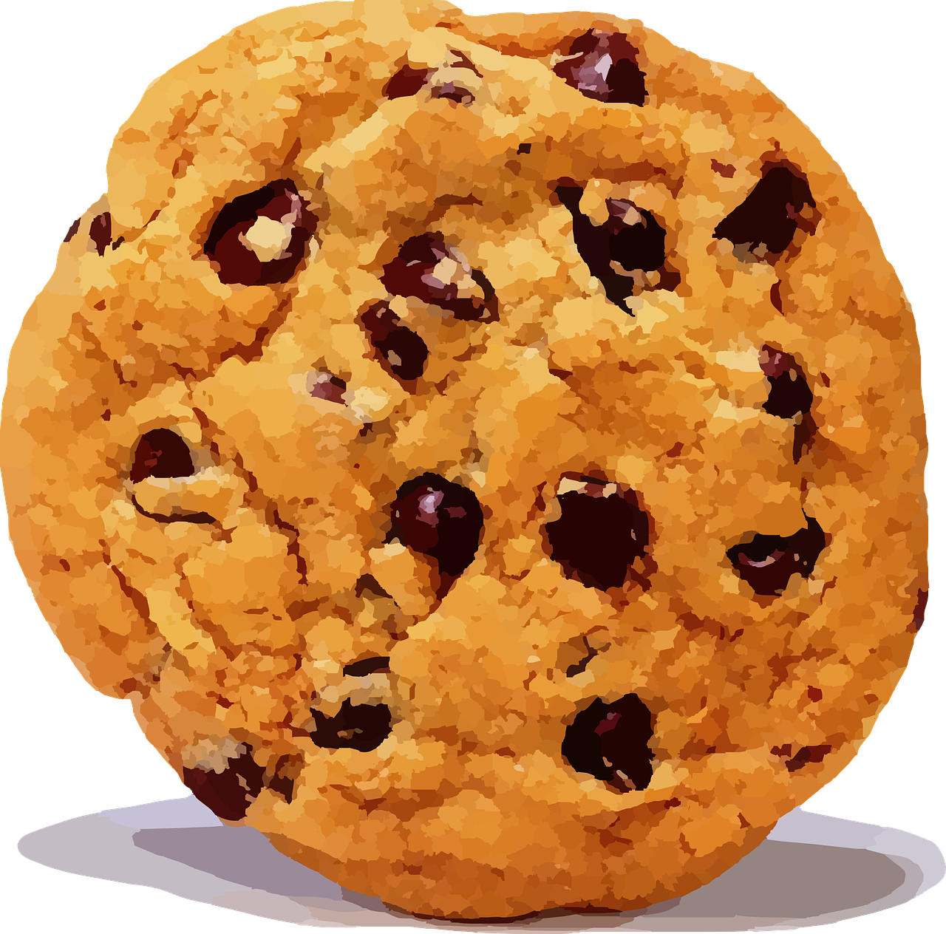
Clicky Biscuits
Project description
Following on from the success of other clicking-based games, this app will allow the user to click on different biscuits that appear on the screen, with each biscuit worth a different number of points. ​
At the end of the game, the user will be presented with their score. ​
​
Notes:
Image source: https://pixabay.com/vectors/cookie-chocolate-chip-blurred-307960

Slide 3
Project 3: Success criteria
Success criteria
Below are some mandatory success criteria. You should add between two and four additional success criteria that you would like your project to be judged on​.
Success criterion | Met?
1. App must have a welcome screen with a button to start the game.
2. The app must increase the score by one every time a biscuit has been clicked.
3. The app must show the user their score after 15 seconds.
4.
5.
6.
7.

Slide 4
Screen designs

Slide 5
Decompose the problem
Decomposition
Use the table below to document how you intend to decompose the problem. Don’t overcomplicate this by adding too many steps; remember that each step can be decomposed further, and use your success criteria as a guide to help you.
Step | Further decomposition
 | 1. 2.

Slide 6
Diary milestone 1
Milestone 1
What have you achieved in this lesson? Don’t forget to include information on anything that went wrong and how you resolved the issues.
Screenshot
What do you need to focus on in the next lesson?

Slide 7
Feedback
Peer feedback
What do you think could be done to help the app meet the success criteria? What other suggestions do you have?
Success criterion | Met?
1. App must have a welcome screen with a button to start the game.
2. The app must increase the score by one every time a biscuit has been clicked.
3. The app must show the user their score after 15 seconds.
4.
5.
6.
7.
What do you think users will like most about the app?

Slide 8
Diary milestone 2
Milestone 2
What have you achieved this lesson? Don’t forget to include information on anything that went wrong and how you resolved the issues.
Screenshot
What do you need to focus on in the next lesson?

Slide 9
Evaluation
Project evaluation
Questions | Responses
Do you think your app will be successful, and why? (For example, which features do you think will appeal to the audience?)
Based on the feedback from your user, what do you think could be improved upon if you had had more time?​
What additional features would you like to add to the app in the future to help keep people engaged with it?

