Slide 1
Lesson 4 Activity 1 - Theme park tickets app
Notes:
Last updated: 01-07-20
This resource is available online at ncce.io/prg3-4-a1-w. Resources are updated regularly — please check that you are using the latest version.
This resource is licensed under the Open Government Licence, version 3. For more information on this licence, see ncce.io/ogl.

Slide 2
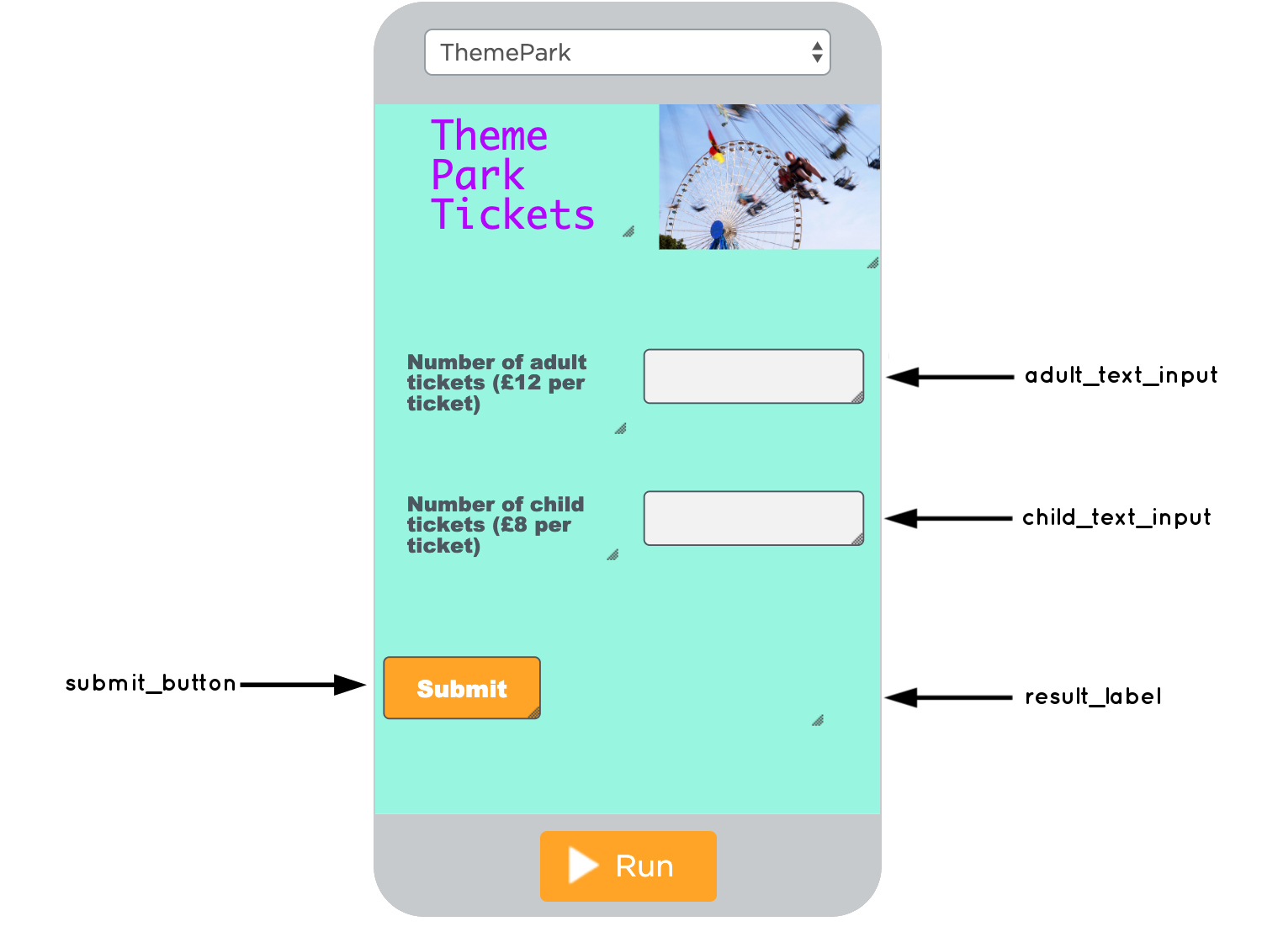
Theme park tickets app
Activity 1
The purpose of this app is to allow the user to enter in the number of adult and child tickets required.
Once the user selects the submit_button, the data will be captured and processed and total will be displayed in the result_label.

Slide 3
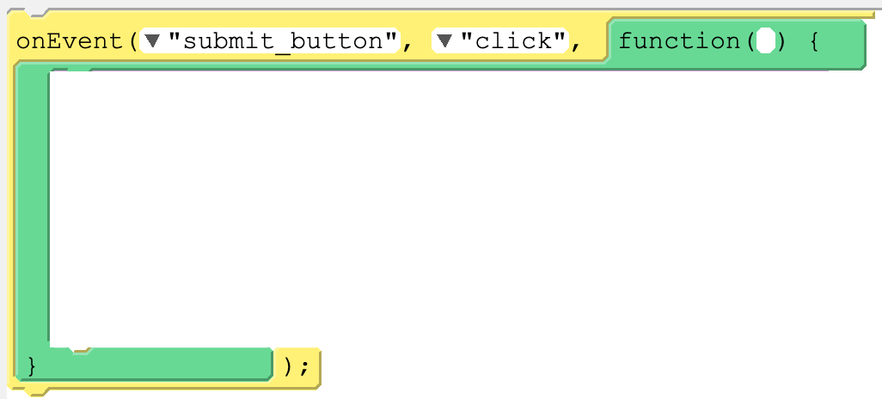
Place the blocks in the correct order to form a working segment of code.
Activity 1

